Slide 1
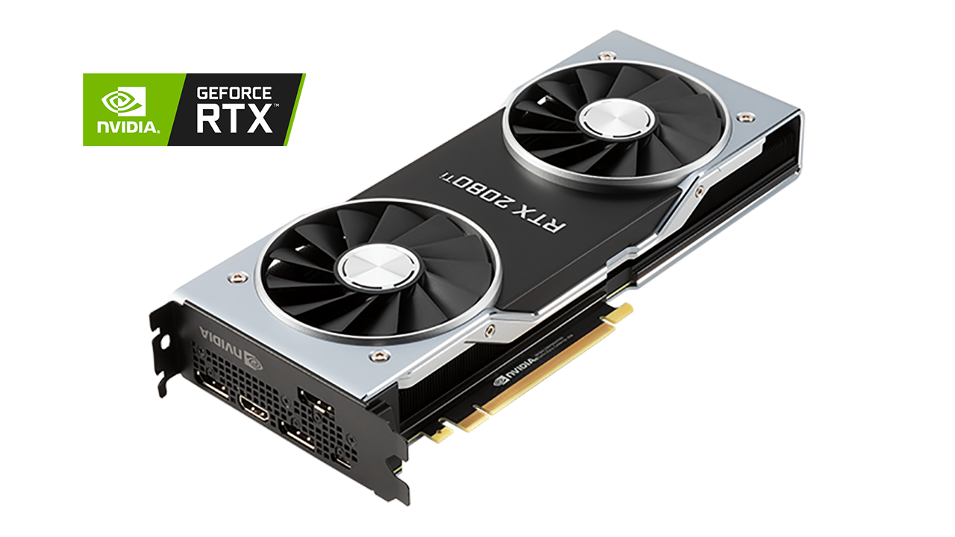
Graphic Cards
Fabian ansorge

Slide 2
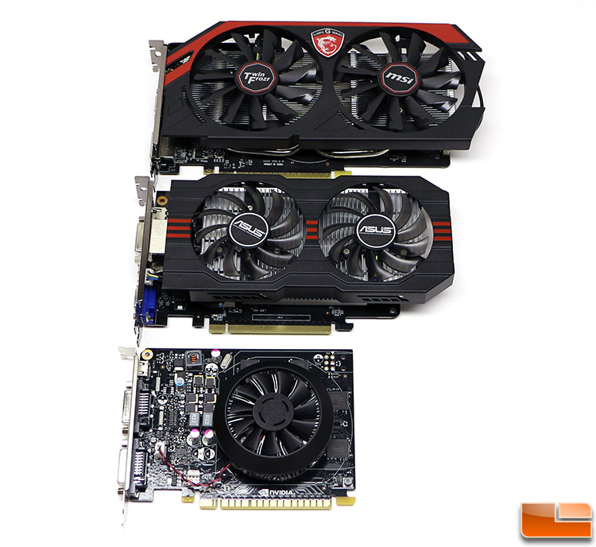
Size

Slide 3
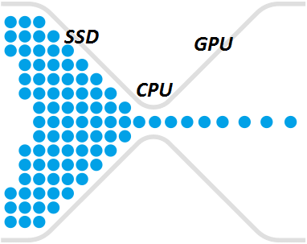
Bottleneck

Slide 4
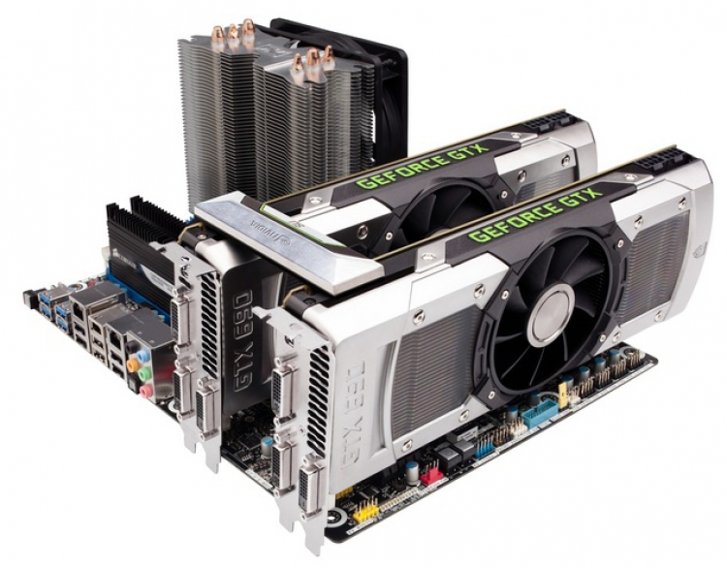
Multi-Card Setup

Slide 5
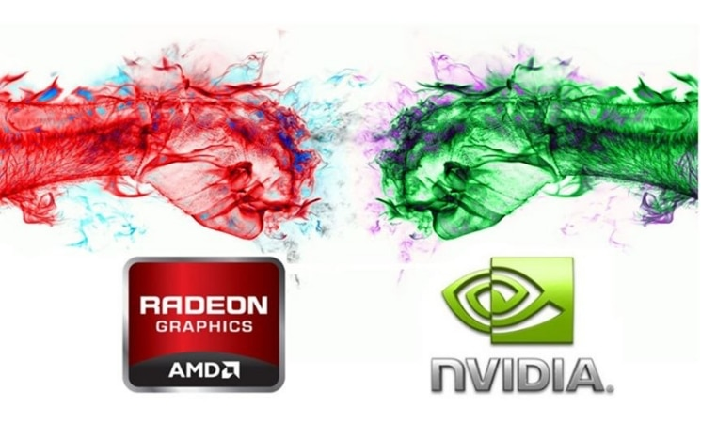
NVIDEA VS AMD

Slide 6
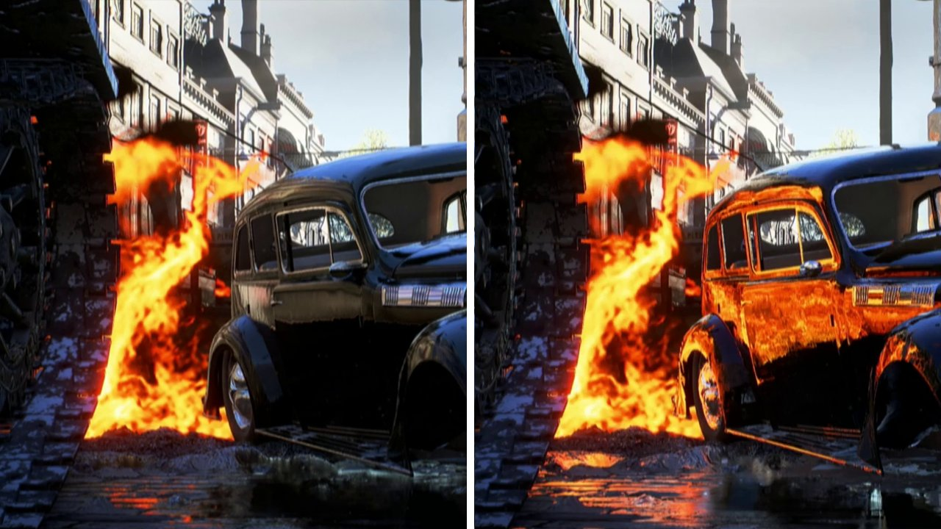
Ray Tracing

Slide 7
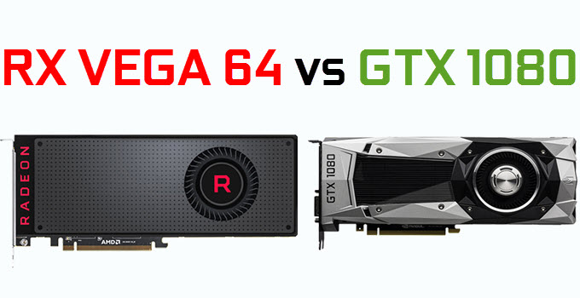
Card Comparison

Slide 8
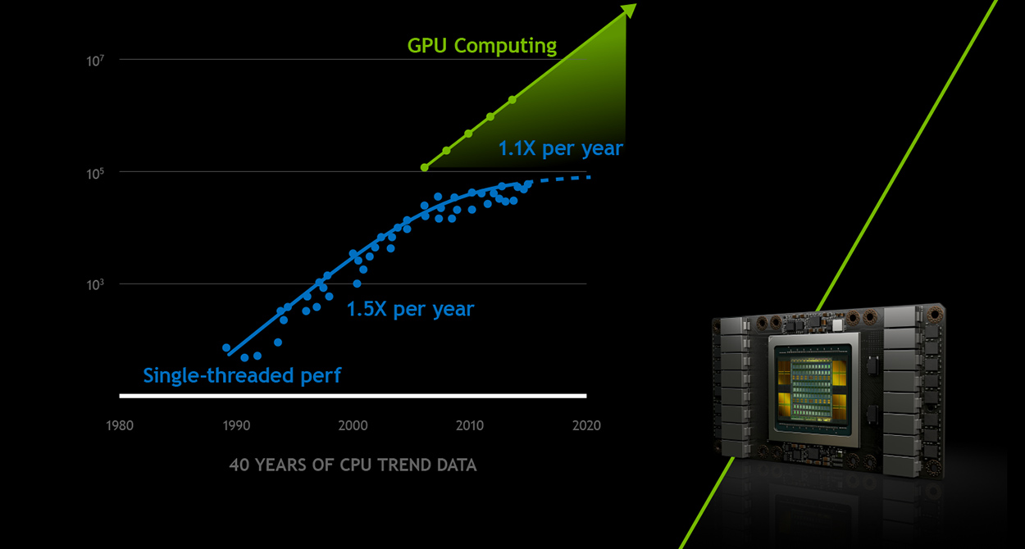
Future?

Slide 9
Thanks for your attention ;)

